Slide 1
MATH 685/ CSI 700/ OR 682
Lecture Notes
Lecture 3.
Solving linear systems

Slide 2
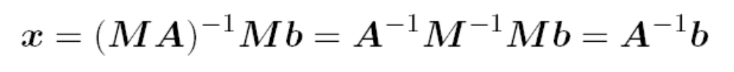
Solving linear systems
To solve linear system, transform it into one whose solution is same but easier to compute
What type of transformation of linear system leaves solution unchanged?
We can premultiply (from left) both sides of linear system
Ax = b by any nonsingular matrix M without affecting
solution
Solution to MAx =Mb is given by

Slide 3
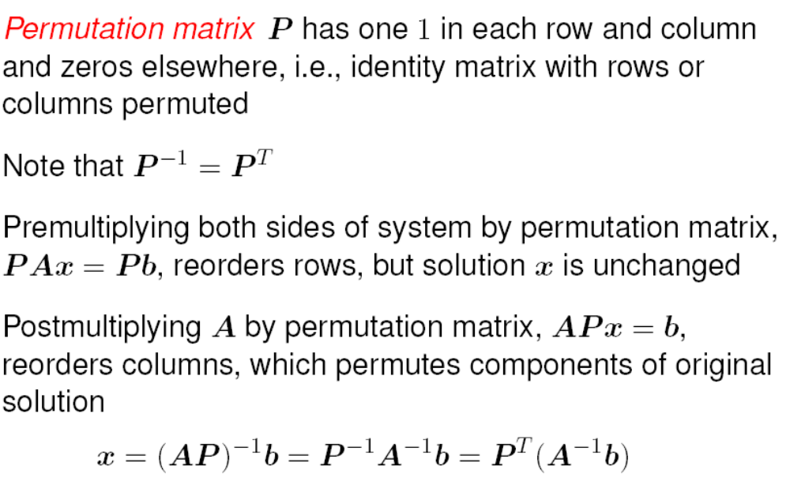
Permutation matrices

Slide 4
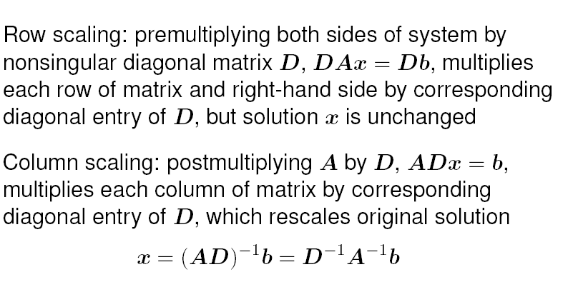
Scaling

Slide 5
Triangular form
What type of linear system is easy to solve?
If one equation in system involves only one component of
solution (i.e., only one entry in that row of matrix is nonzero), then that component can be computed by division
If another equation in system involves only one additional solution component, then by substituting one known component into it, we can solve for other component
If this pattern continues, with only one new solution component per equation, then all components of solution can be computed in succession.
System with this property is called triangular

Slide 6
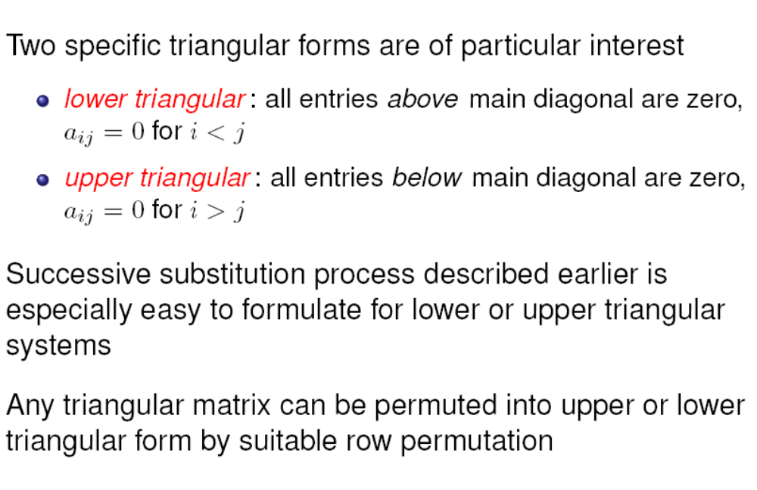
Triangular form

Slide 7
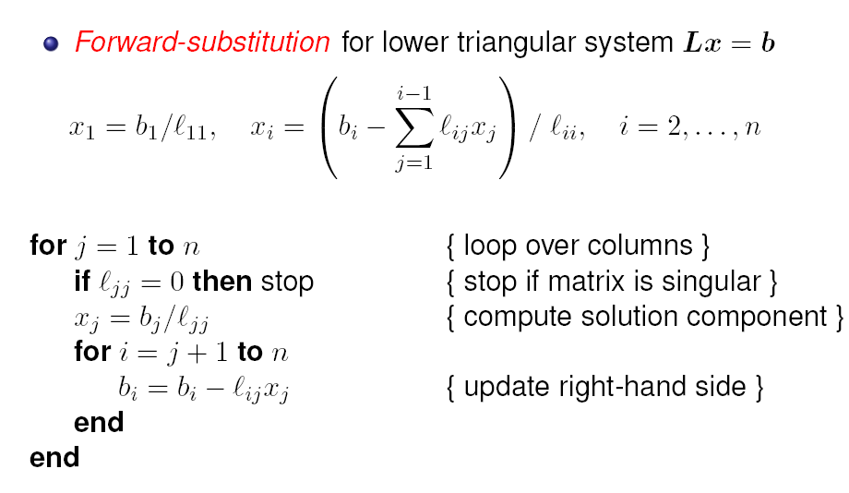
Gaussian elimination

Slide 8
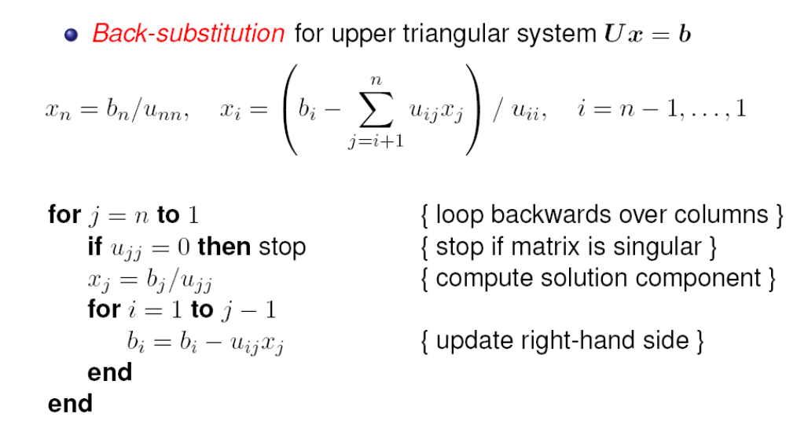
Gaussian elimination

Slide 9
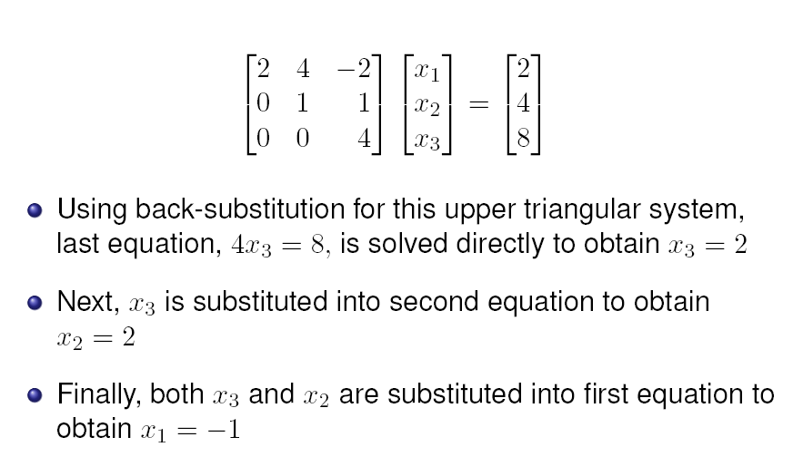
Example

Slide 10
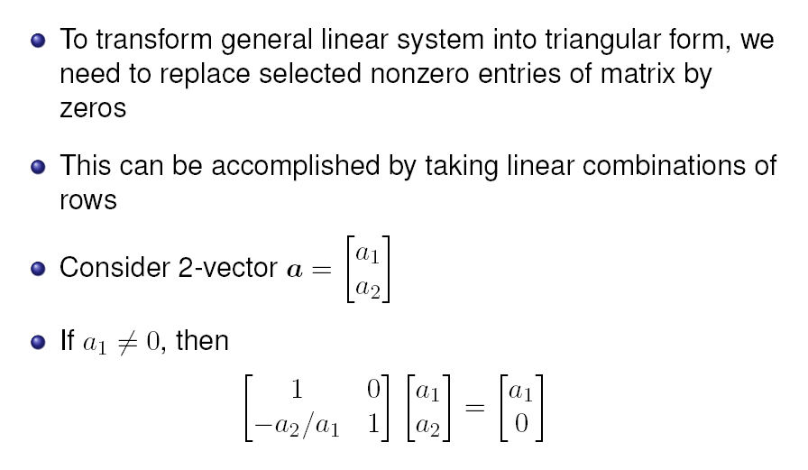
Elimination

Slide 11
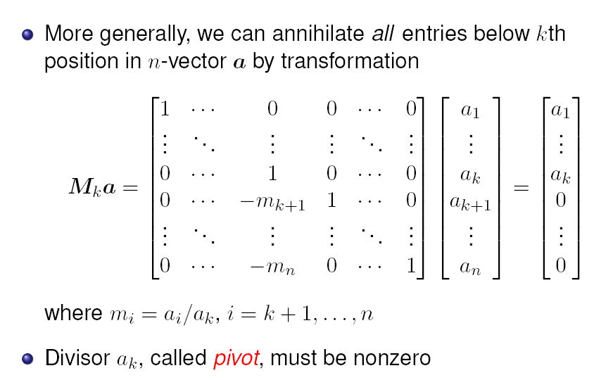
Elimination matrices

Slide 12
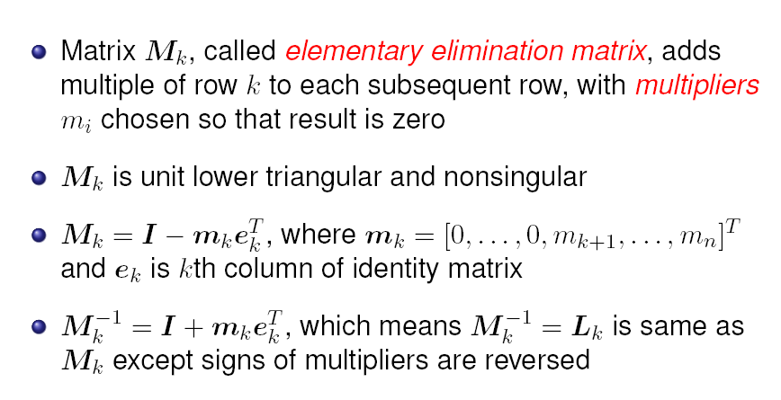
Elimination matrices

Slide 13
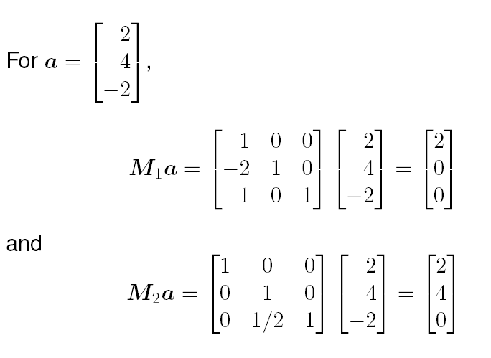
Example

Slide 14
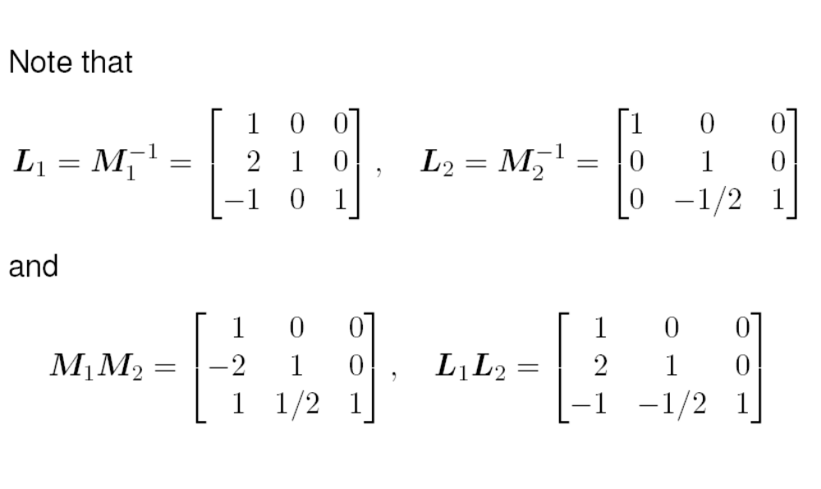
Example

Slide 15
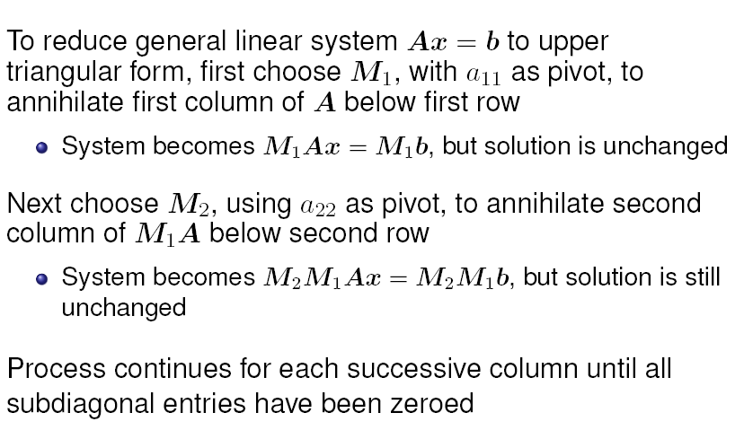
Gaussian elimination

Slide 16
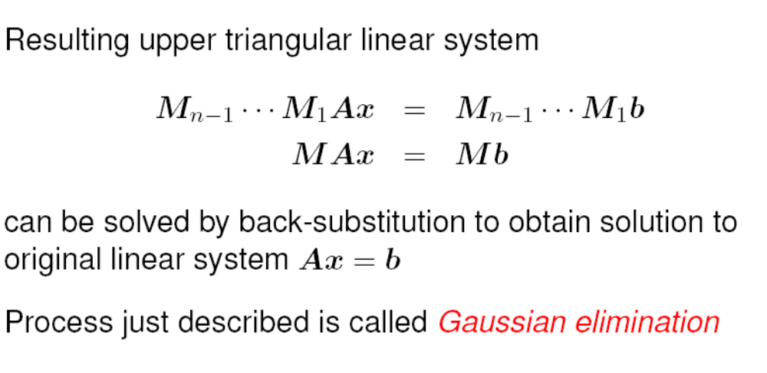
Gaussian elimination

Slide 17
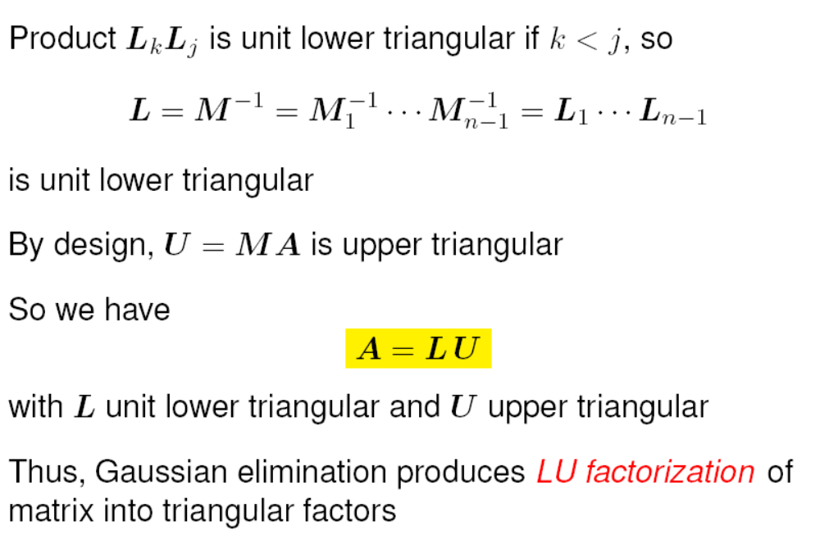
LU decomposition

Slide 18
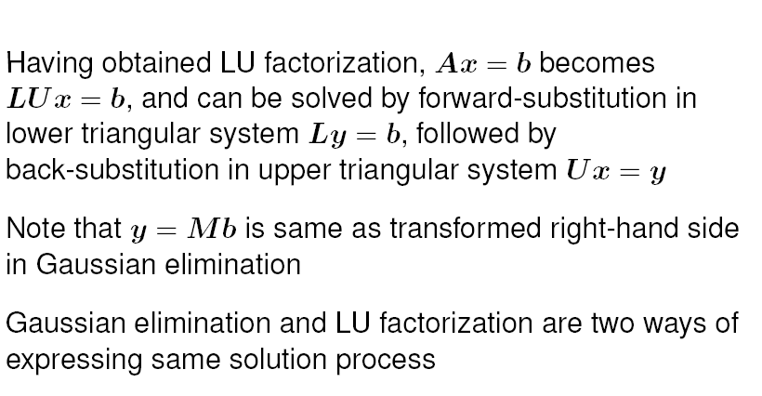
LU decomposition

Slide 19
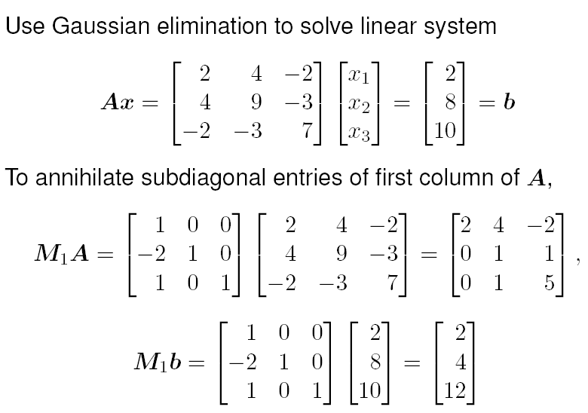
Example

Slide 20
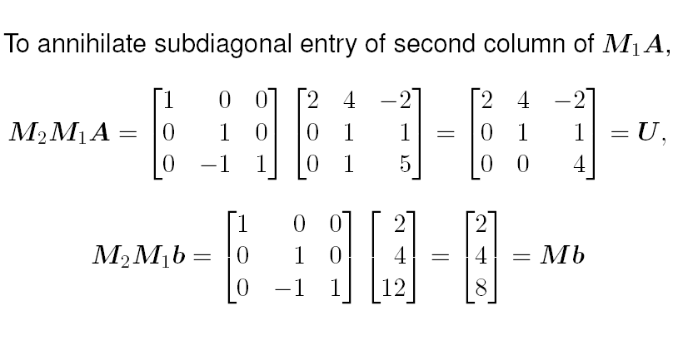
Example

Slide 21
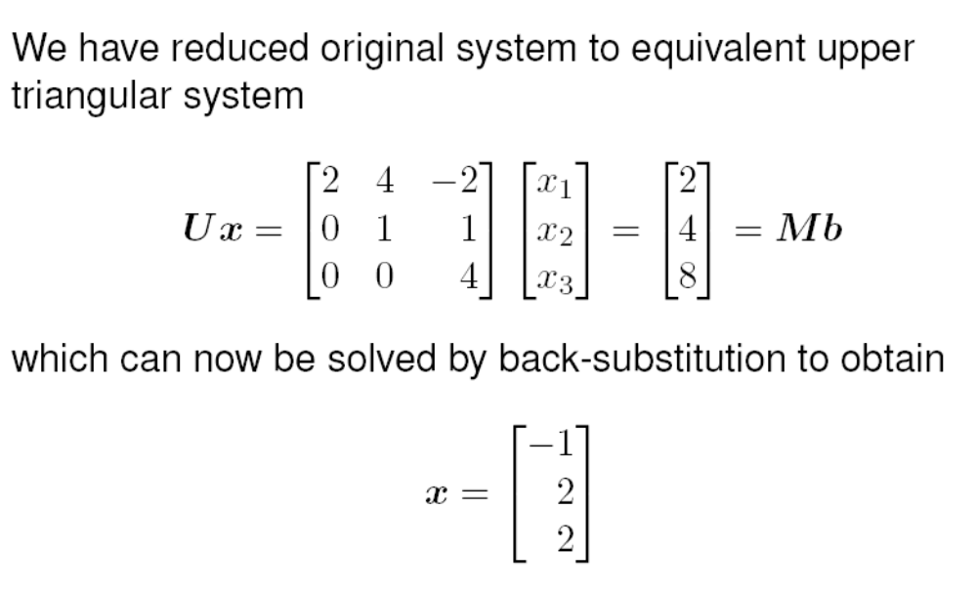
Example

Slide 22
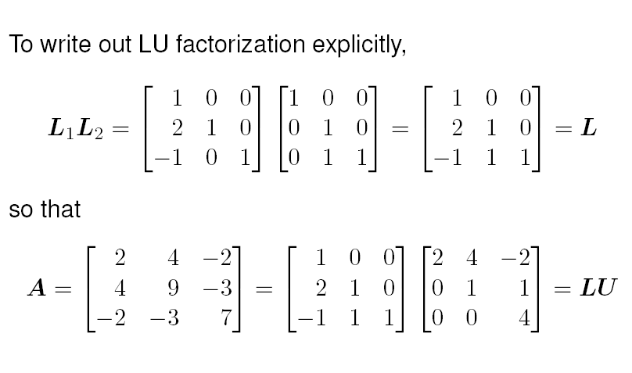
Example

Slide 23
Row interchanges
Gaussian elimination breaks down if leading diagonal entry of remaining unreduced matrix is zero at any stage
Easy fix: if diagonal entry in column k is zero, then interchange row k with some subsequent row having nonzero entry in column k and then proceed as usual
If there is no nonzero on or below diagonal in column k, then there is nothing to do at this stage, so skip to next column
Zero on diagonal causes resulting upper triangular matrix U to be singular, but LU factorization can still be completed
Subsequent back-substitution will fail, however, as it should for singular matrix

Slide 24
Partial pivoting
In principle, any nonzero value will do as pivot, but in practice pivot should be chosen to minimize error propagation
To avoid amplifying previous rounding errors when multiplying remaining portion of matrix by elementary elimination matrix, multipliers should not exceed 1 in magnitude
This can be accomplished by choosing entry of largest magnitude on or below diagonal as pivot at each stage
Such partial pivoting is essential in practice for numerically stable implementation of Gaussian elimination for general linear systems

Slide 25
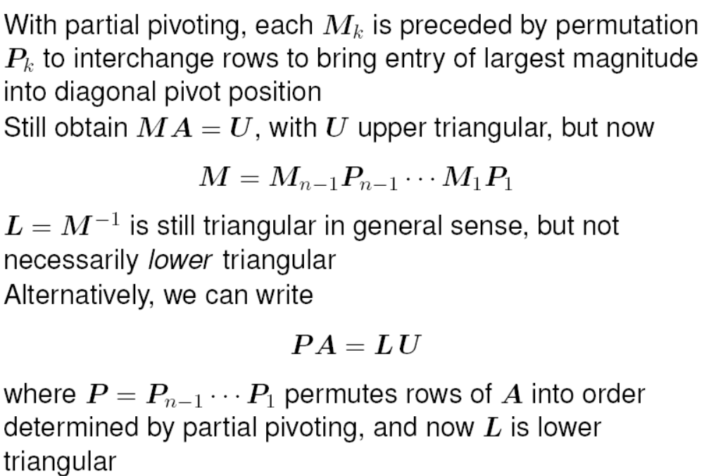
LU with pivoting

Slide 26
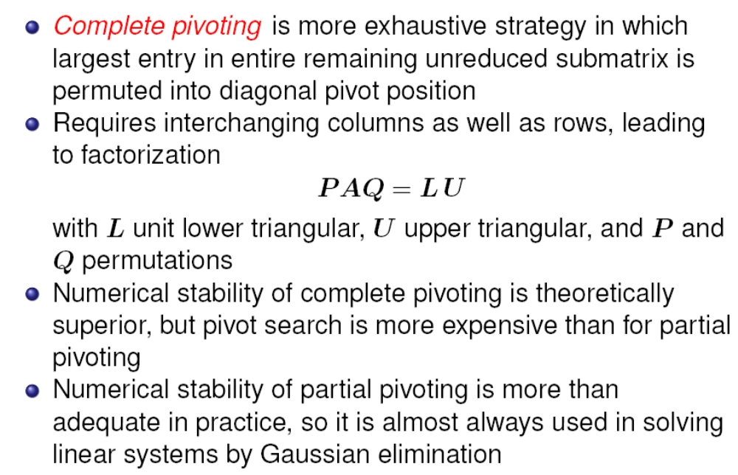
Complete pivoting

Slide 27
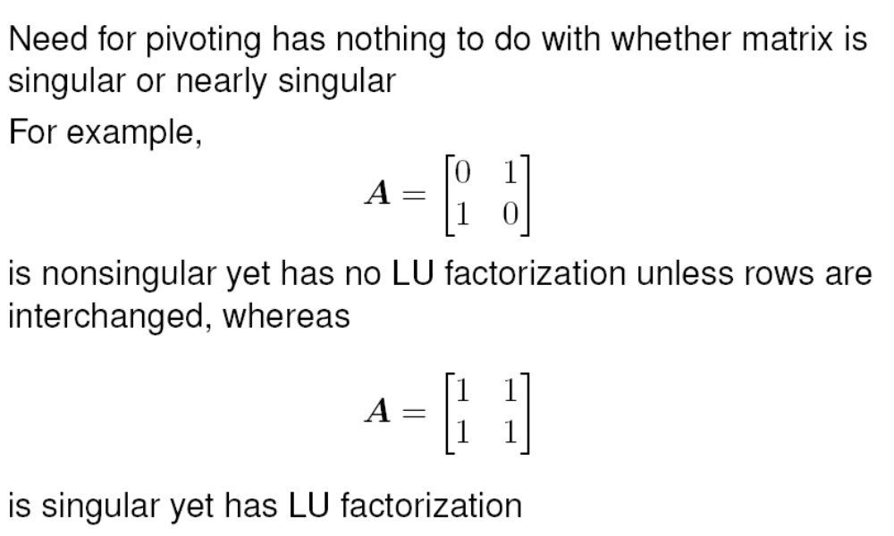
Example

Slide 28
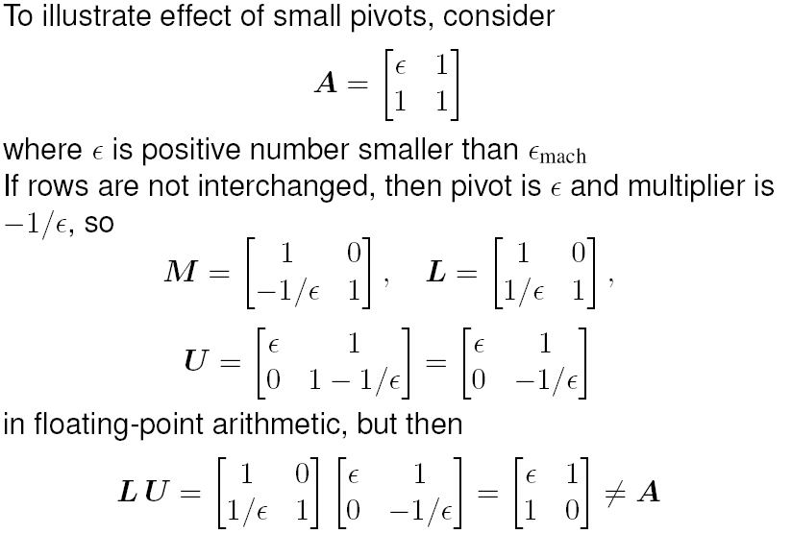
Small pivots

Slide 29
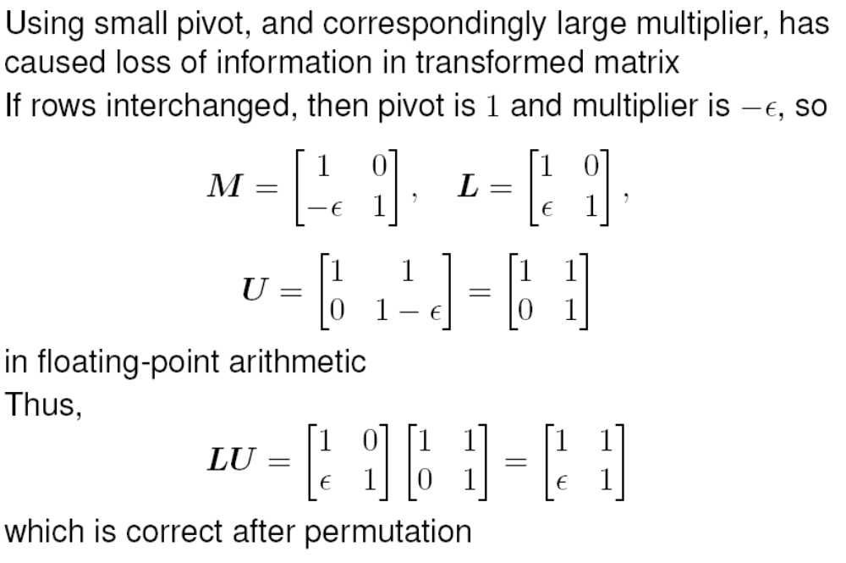
Small pivots

Slide 30
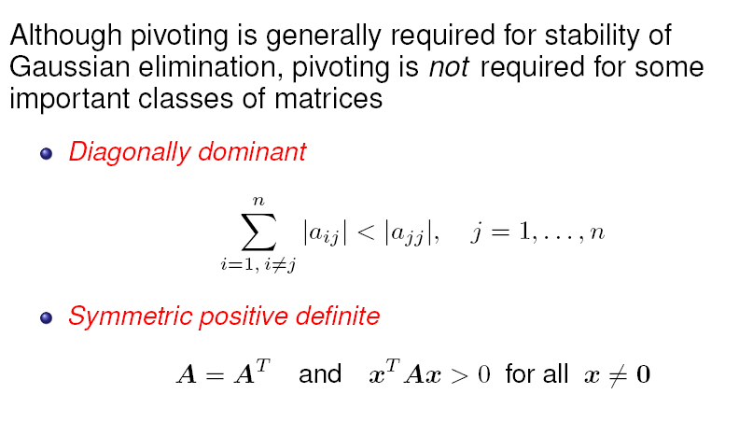
Pivoting not required sometimes

Slide 31
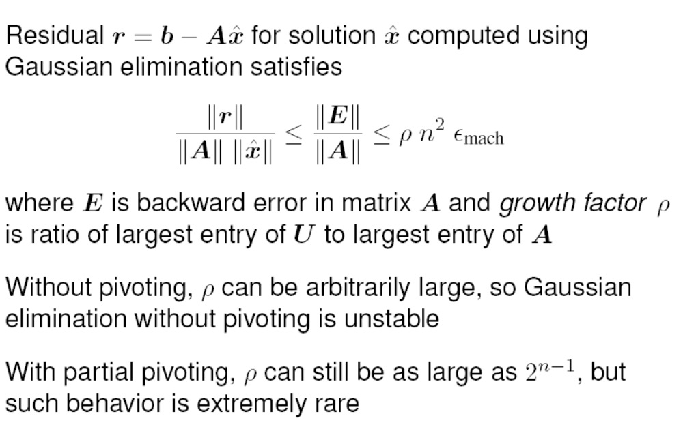
Residual

Slide 32
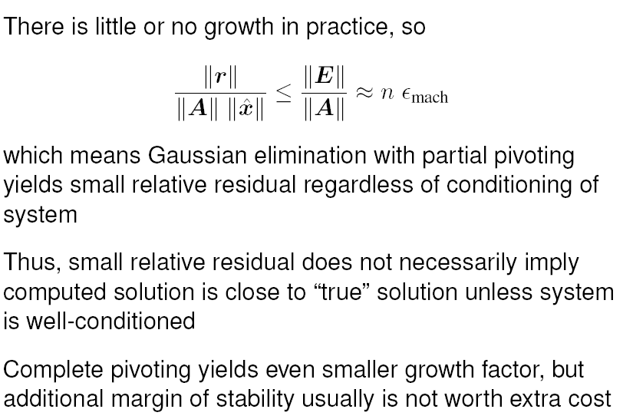
Residual

Slide 33
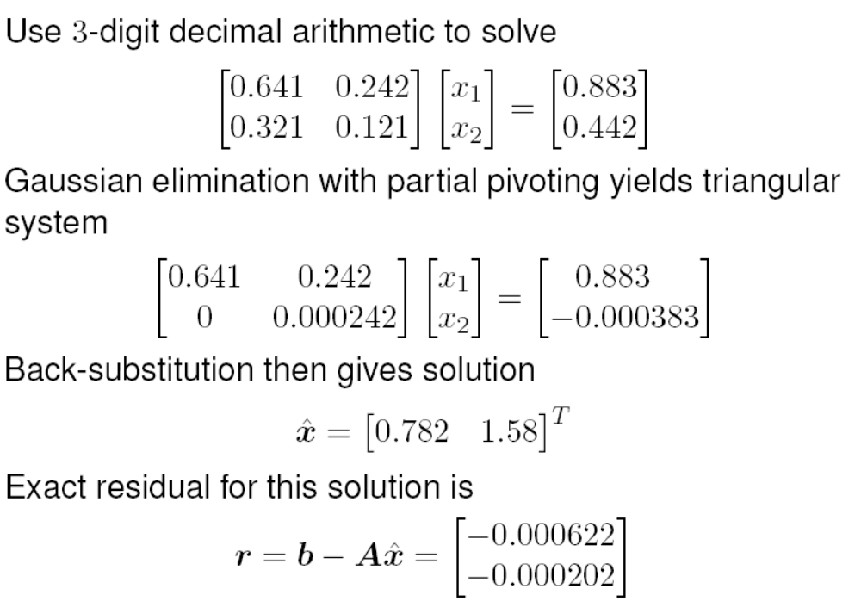
Example

Slide 34
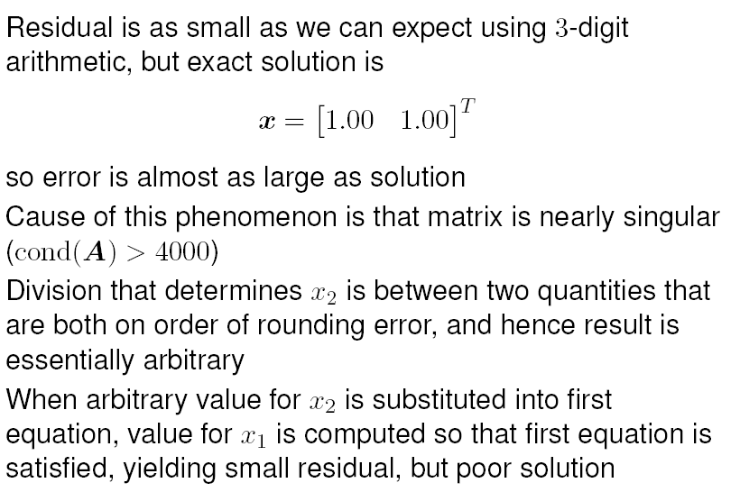
Example

Slide 35
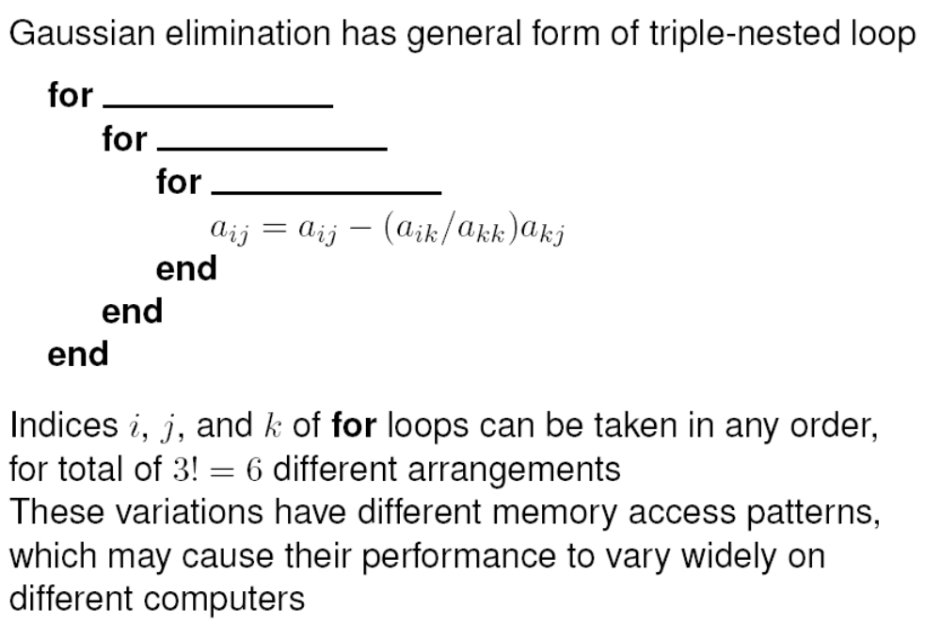
Implementing Gaussian elimination

Slide 36
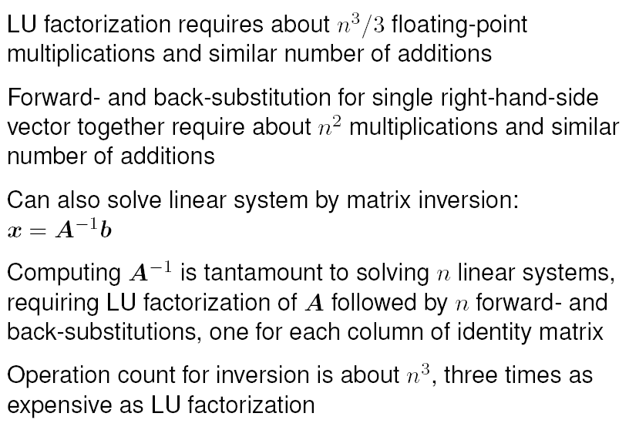
Complexity

Slide 37
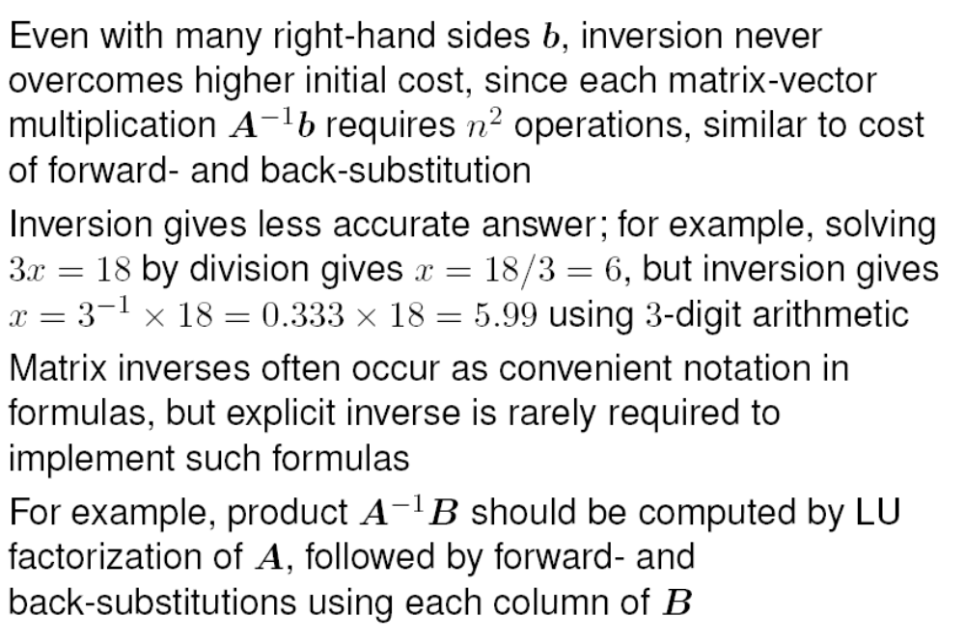
Inversion vs. Factorization

Slide 38
Modified systems
If right-hand side of linear system changes but matrix does not, then LU factorization need not be repeated to solve new system
Only forward- and back-substitution need be repeated for new right-hand side
This is substantial savings in work, since additional
  triangular solutions cost only O(n²) work, in contrast to
  O(n³) cost of factorization

Slide 39
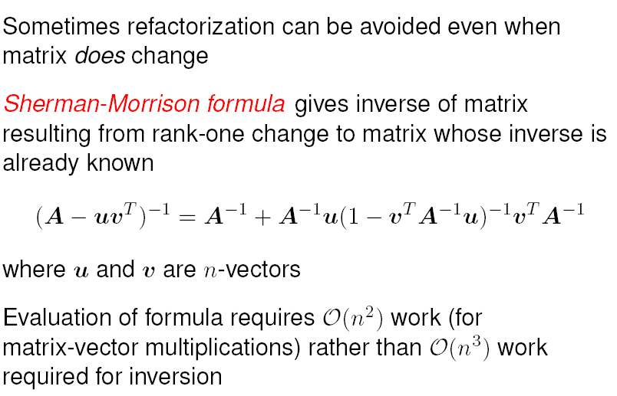
Rank-one update

Slide 40
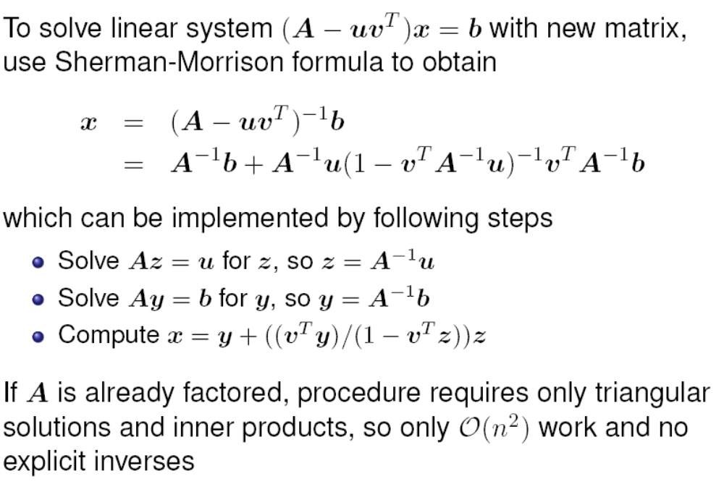
Rank-one update

Slide 41
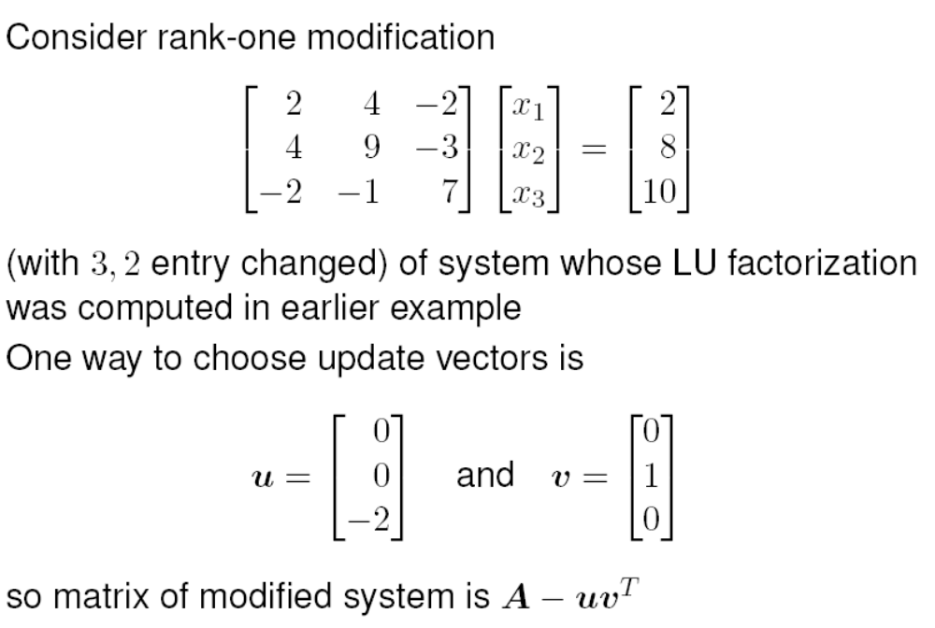
Example

Slide 42
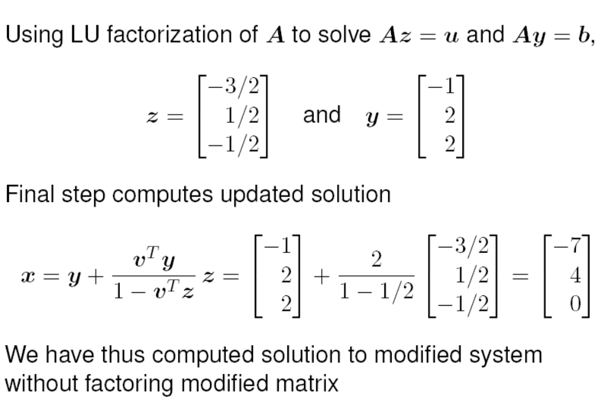
Example

Slide 43
Scaling
In principle, solution to linear system is unaffected by diagonal scaling of matrix and right-hand-side vector
In practice, scaling affects both conditioning of matrix and selection of pivots in Gaussian elimination, which in turn affect numerical accuracy in finite-precision arithmetic
It is usually best if all entries (or uncertainties in entries) of matrix have about same size
Sometimes it may be obvious how to accomplish this by choice of measurement units for variables, but there is no foolproof method for doing so in general
Scaling can introduce rounding errors if not done carefully

Slide 44
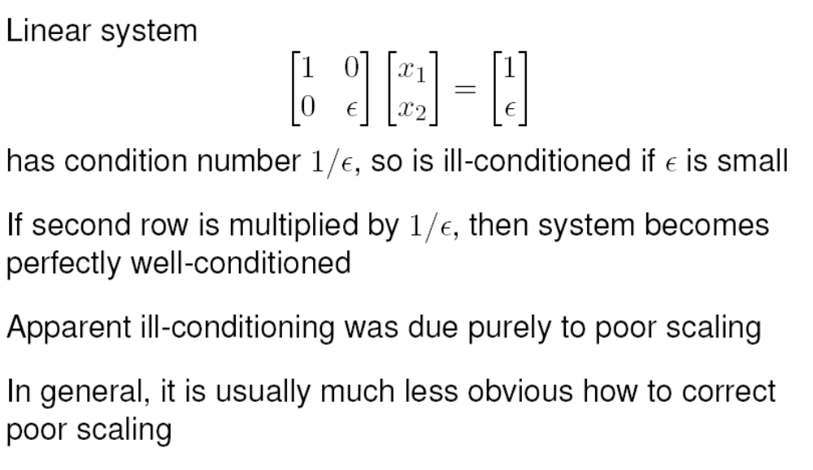
Scaling

Slide 45
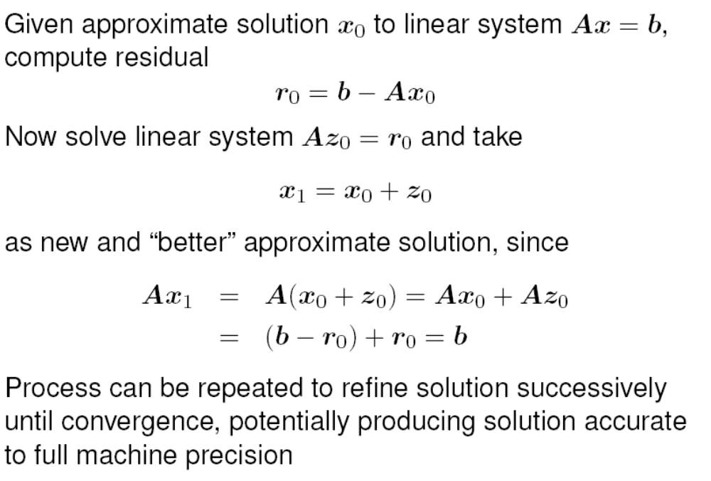
Iterative refinement

Slide 46
Iterative refinement
Iterative refinement requires double storage, since both original matrix and its LU factorization are required
Due to cancellation, residual usually must be computed with higher precision for iterative refinement to produce meaningful improvement
For these reasons, iterative improvement is often impractical to use routinely, but it can still be useful in some circumstances
For example, iterative refinement can sometimes stabilize otherwise unstable algorithm

Slide 47
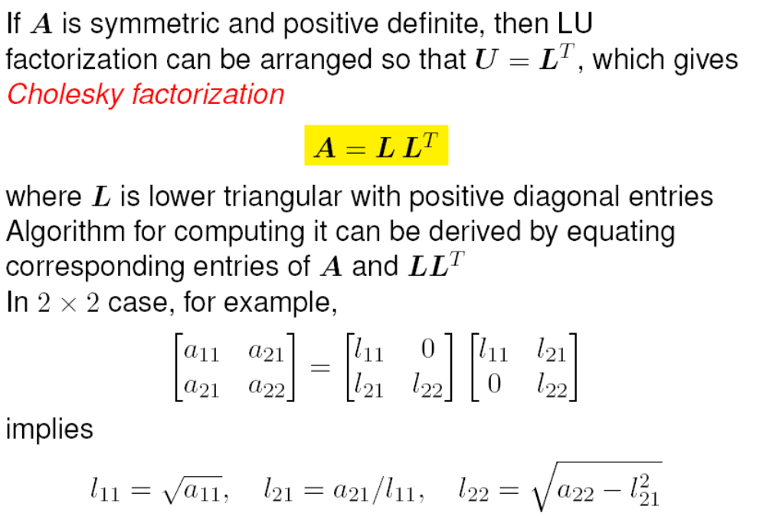
SPD matrices

Slide 48
Cholesky decomposition
Features of Cholesky algorithm for symmetric positive definite matrices
  All n square roots are of positive numbers, so algorithm is well defined
  No pivoting is required to maintain numerical stability
  Only lower triangle of A is accessed, and hence upper triangular portion need not be stored
  Only n³/6 multiplications and similar number of additions are required
Thus, Cholesky factorization requires only about half work and half storage compared with LU factorization of general matrix by Gaussian elimination, and also avoids need for pivoting

Slide 49
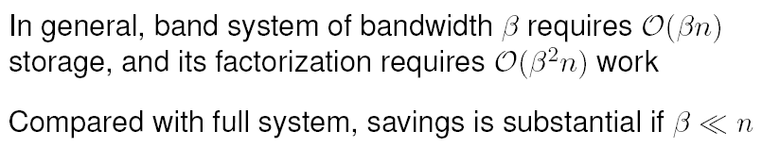
Banded matrices
Gaussian elimination for band matrices differs little from general case — only ranges of loops change
Typically matrix is stored in array by diagonals to avoid storing zero entries
If pivoting is required for numerical stability, bandwidth can grow (but no more than double)
General purpose solver for arbitrary bandwidth is similar to code for Gaussian elimination for general matrices
For fixed small bandwidth, band solver can be extremely simple, especially if pivoting is not required for stability

Slide 50
Iterative vs. direct methods
Gaussian elimination is direct method for solving linear system, producing exact solution in finite number of steps (in exact arithmetic)
Iterative methods begin with initial guess for solution and successively improve it until desired accuracy attained
In theory, it might take infinite number of iterations to converge to exact solution, but in practice iterations are terminated when residual is as small as desired
For some types of problems, iterative methods have significant advantages over direct methods

